Slide 1
Woods Chapel Church 175 Hwy 230 Brookland, AR

Slide 9
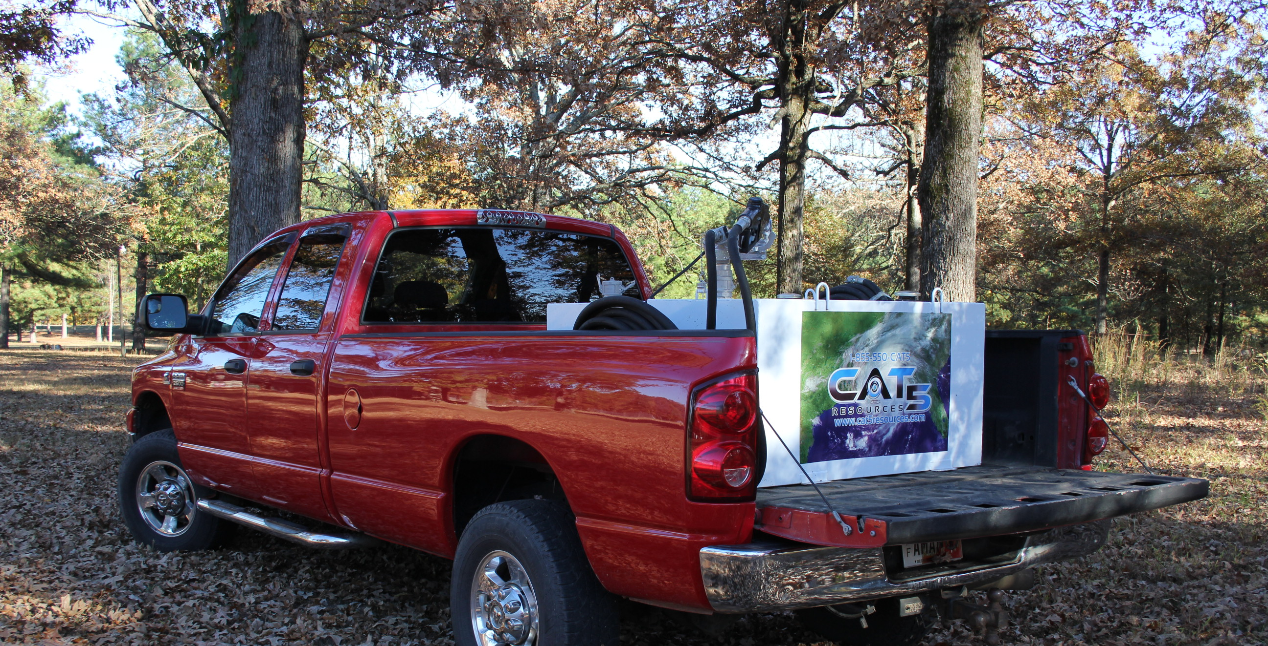

Slide 13
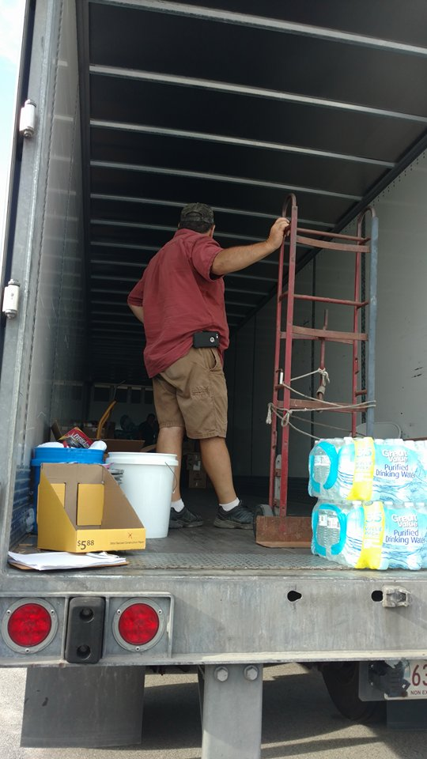

Slide 16
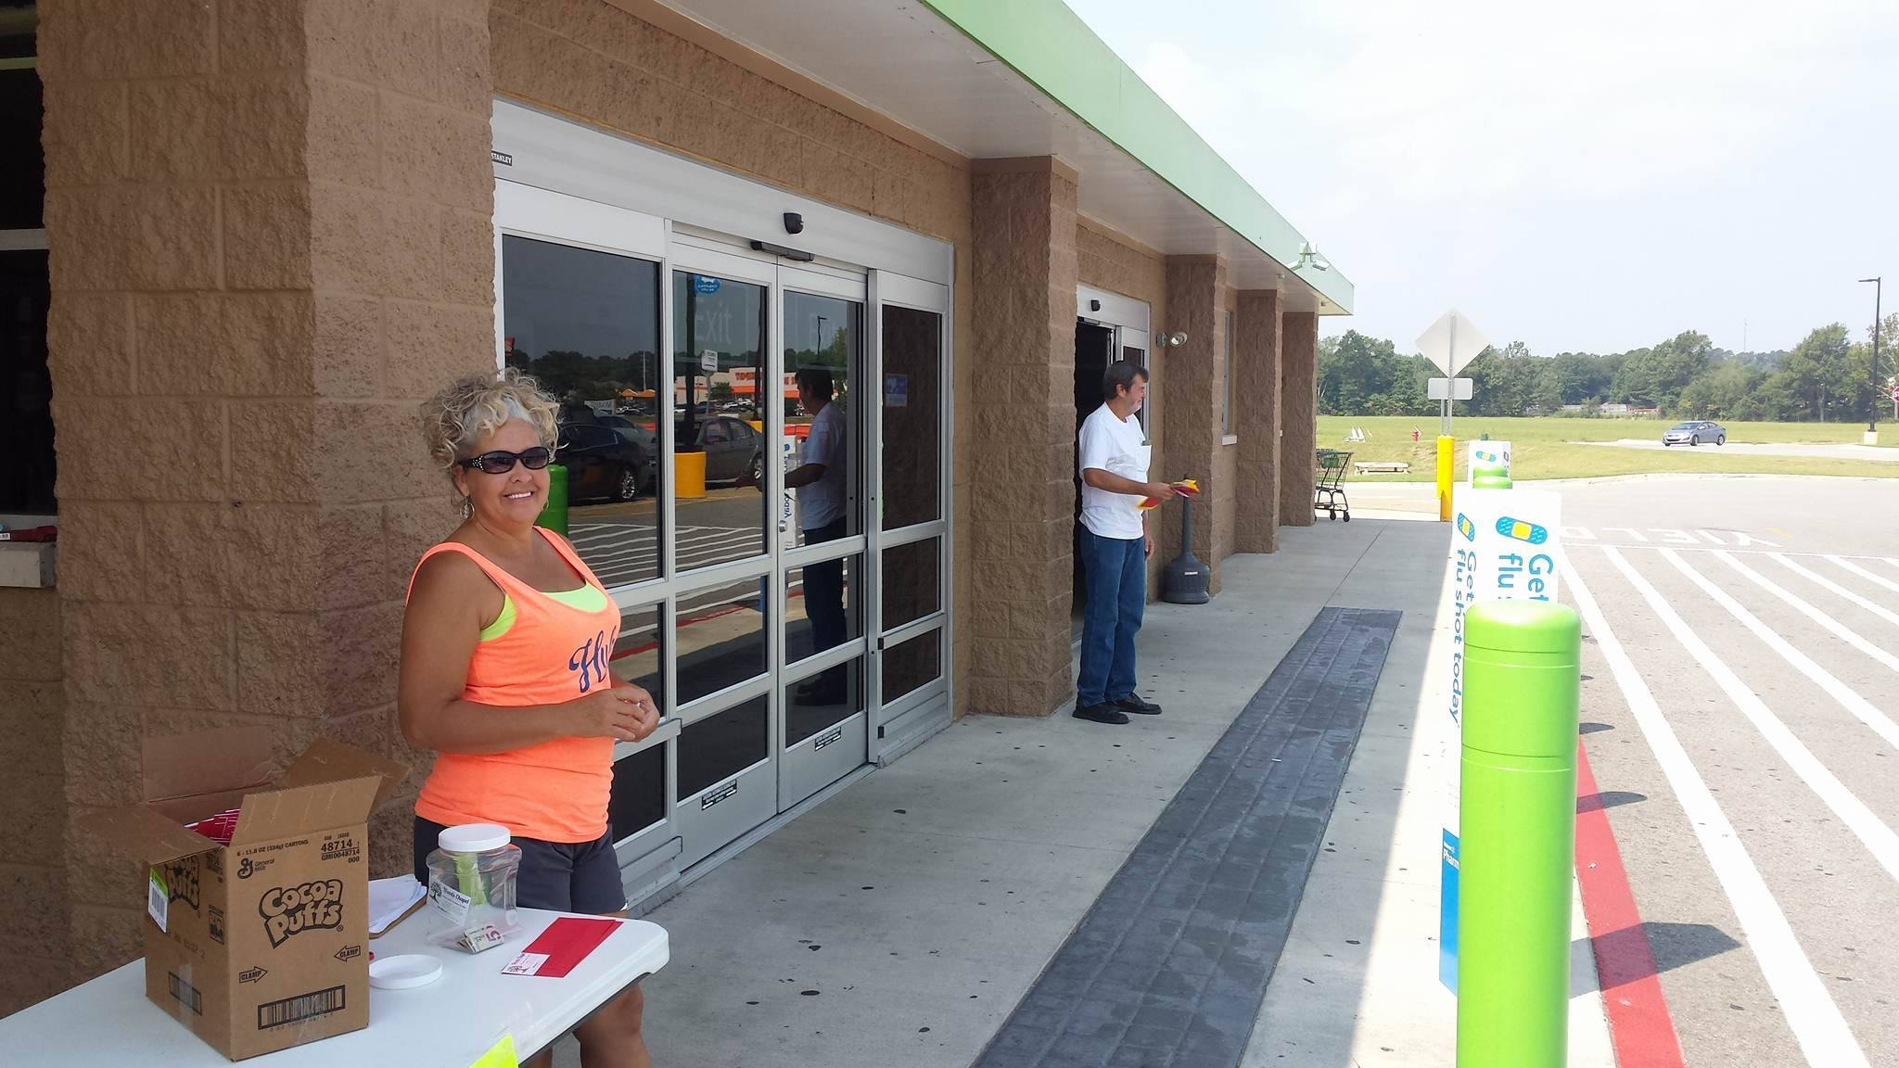
Wal-Mart Parker Rd. Jonesboro, Ar

Slide 18
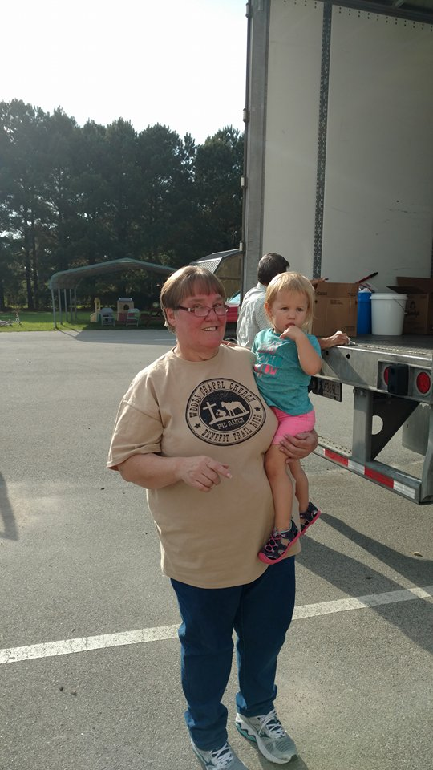

Slide 20
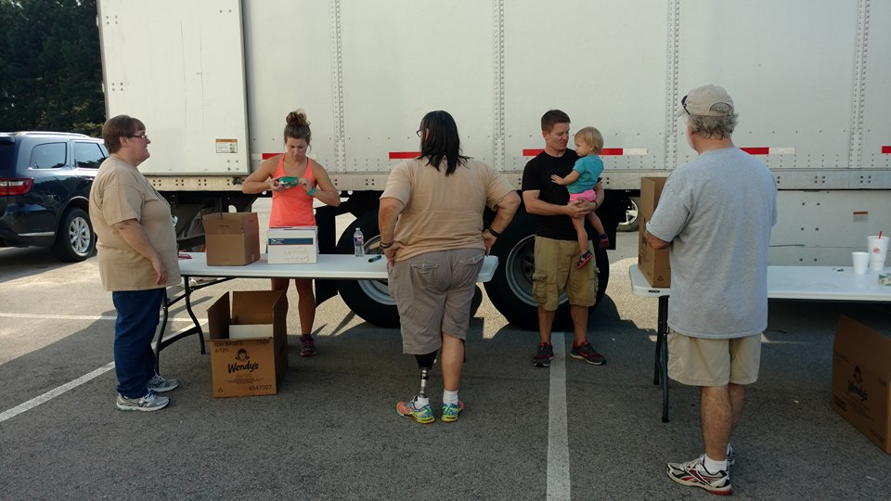

Slide 25
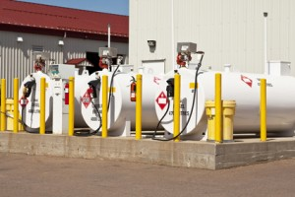

Slide 27
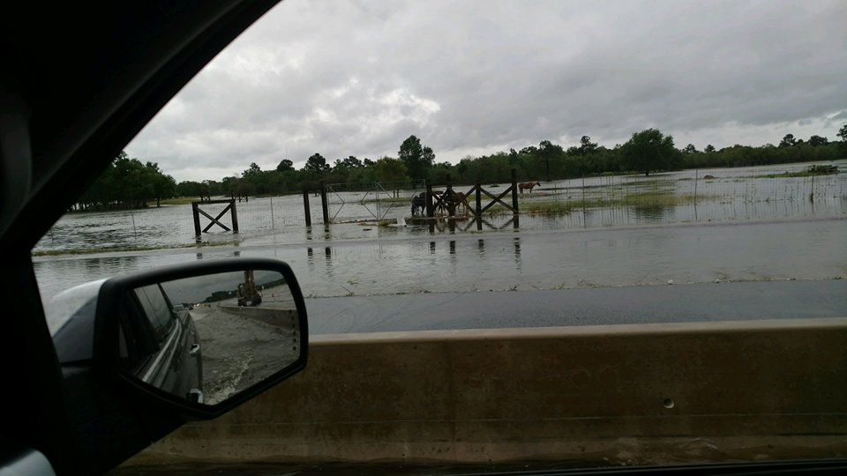

Slide 28
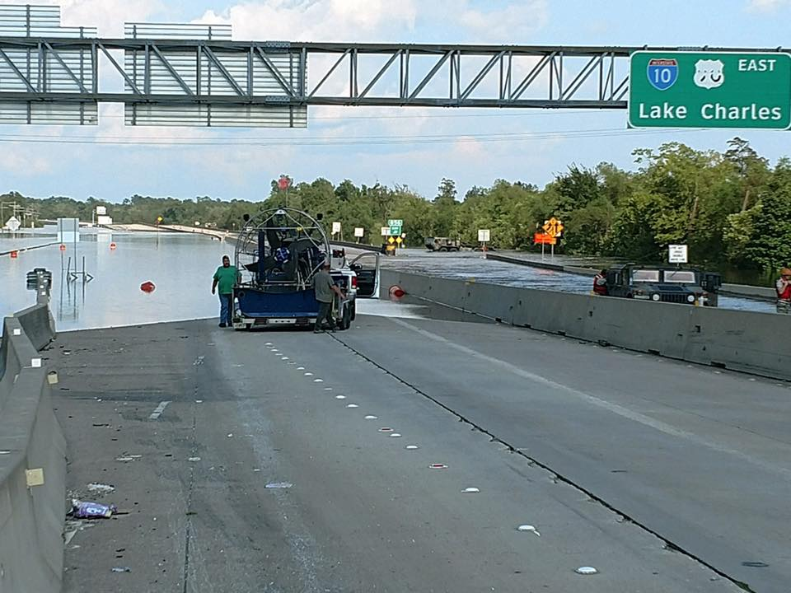

Slide 29
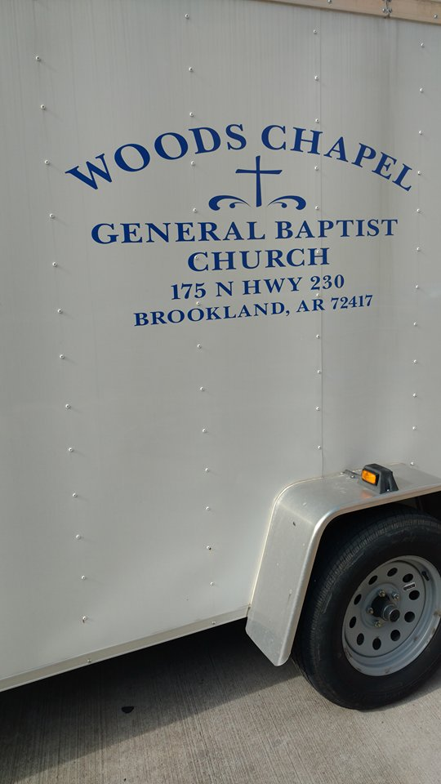

Slide 30
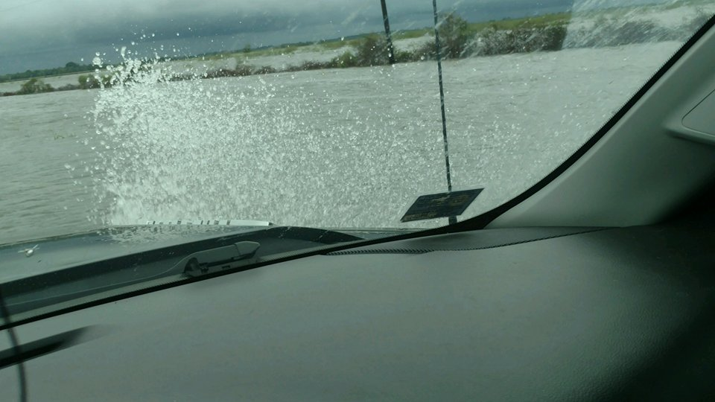

Slide 31
Cat 5 Resources keeping
the lines of communication going

Slide 32
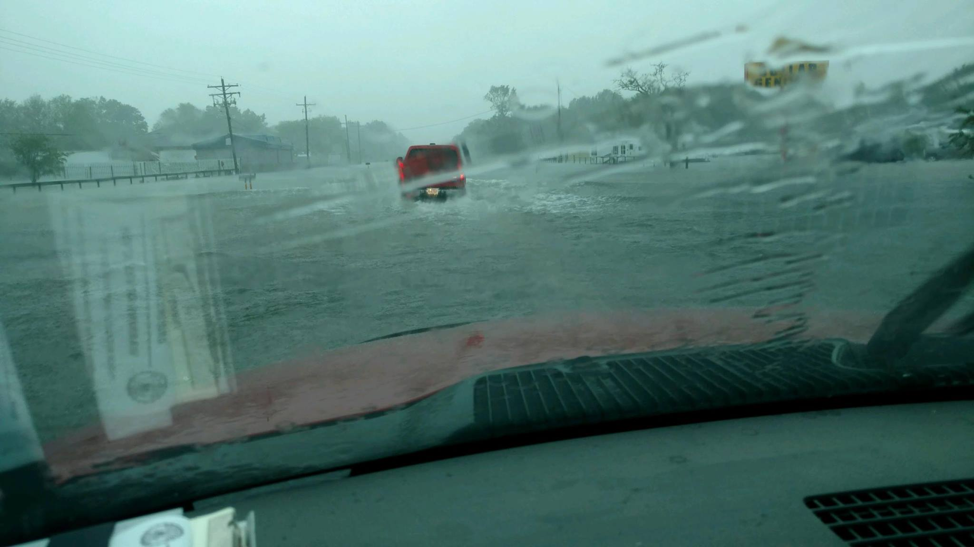

Slide 33
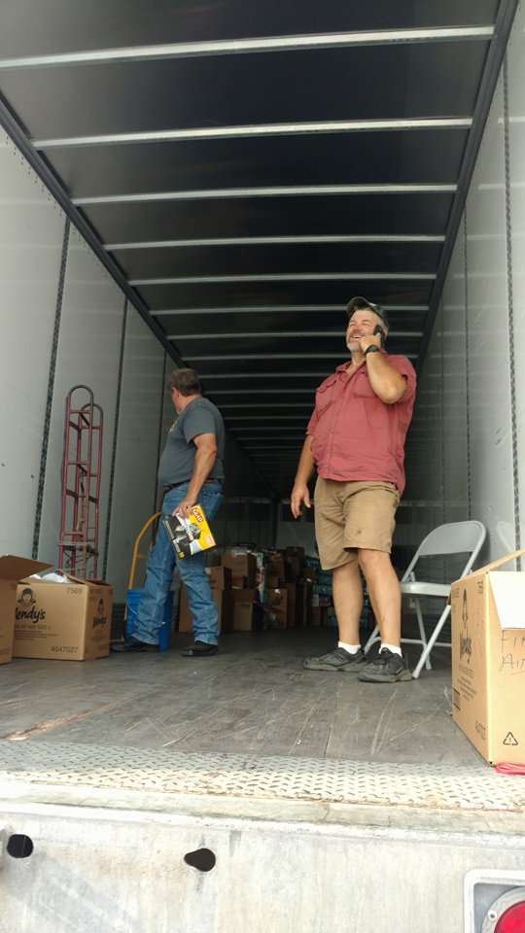
Huge Thank You to
Gary Beard Trucking,
Trumann, AR for
the 18 Wheeler Delivery of Supply donations

Slide 34
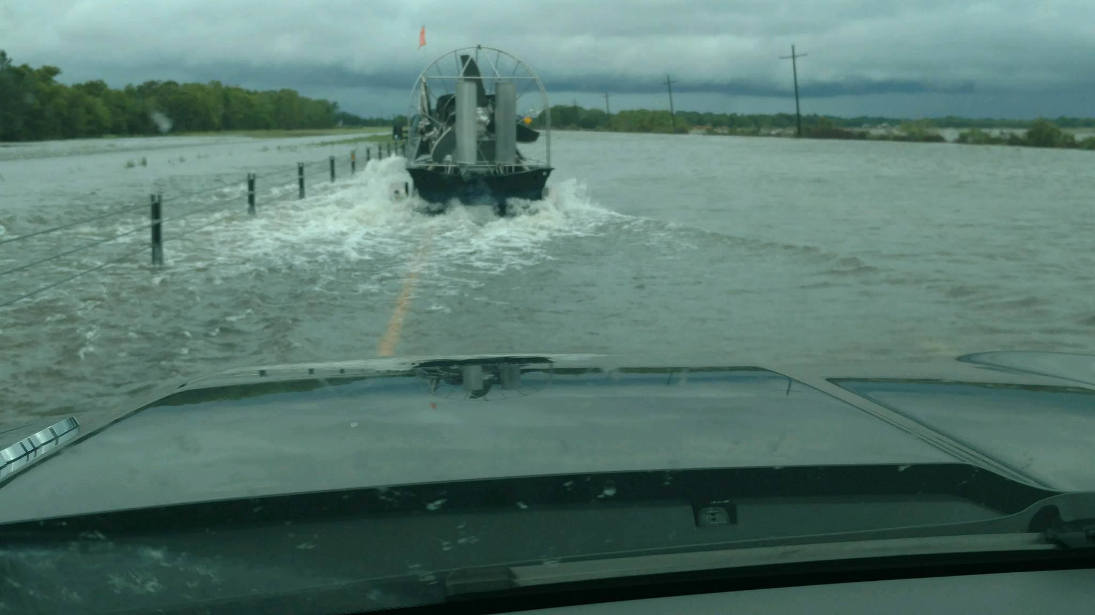

Slide 35
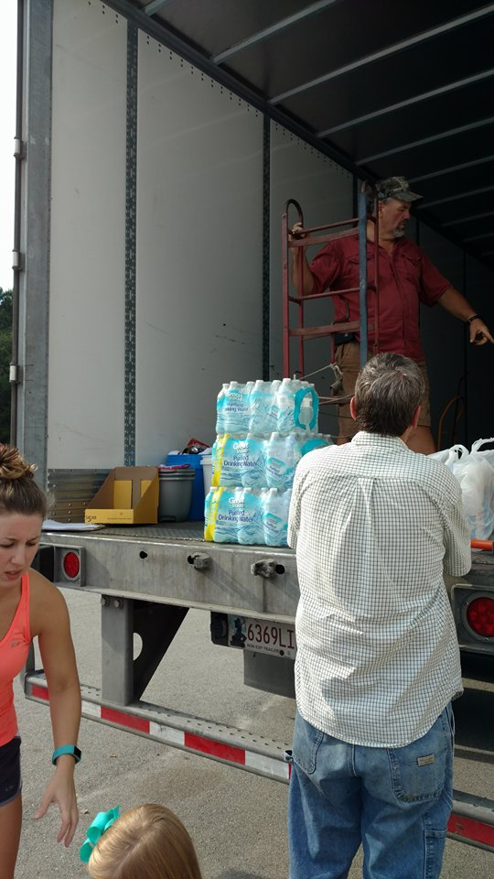

Slide 36
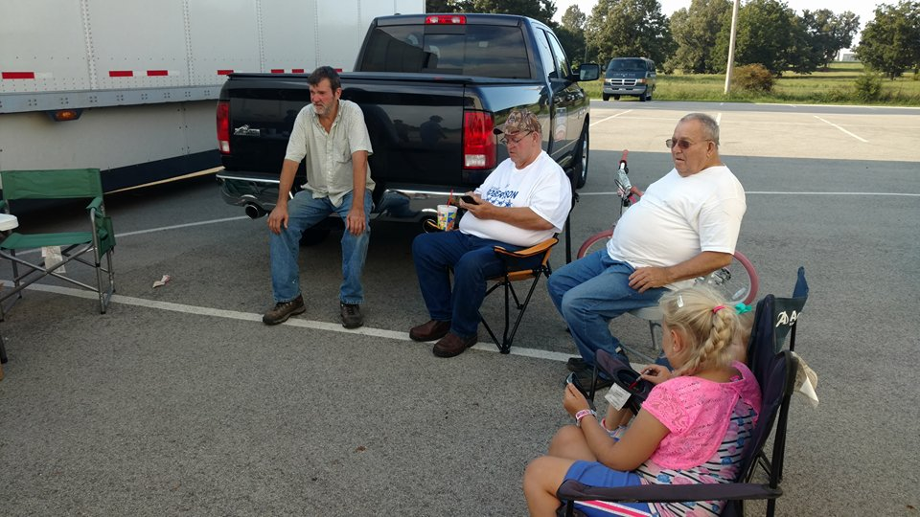

Slide 37
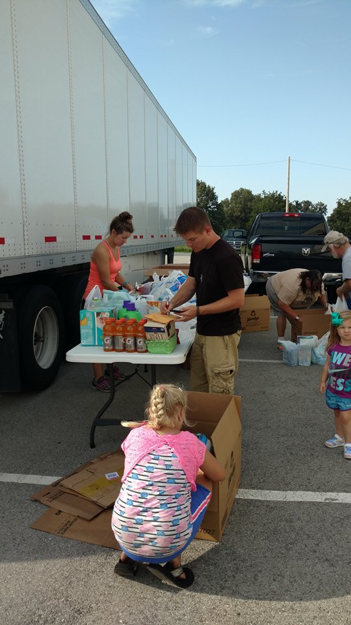

Slide 38
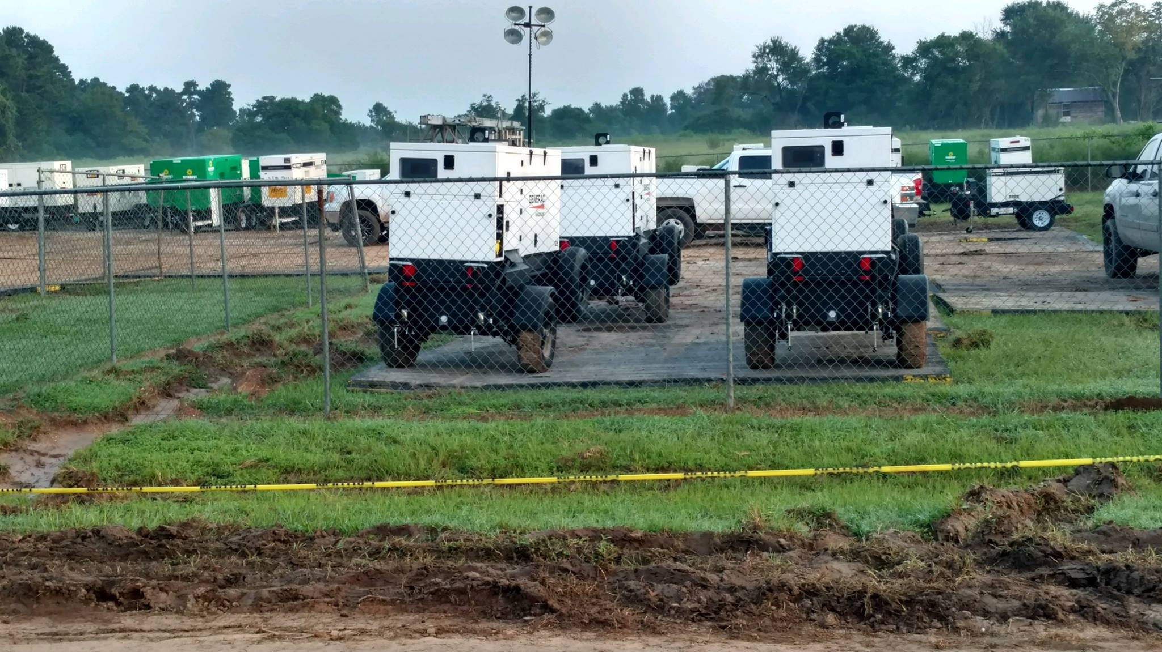

Slide 39
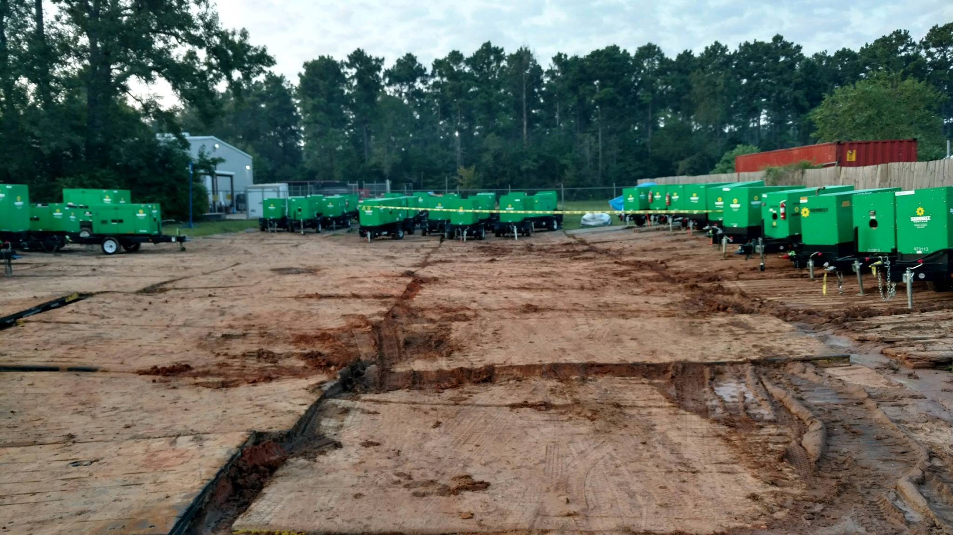

Slide 40
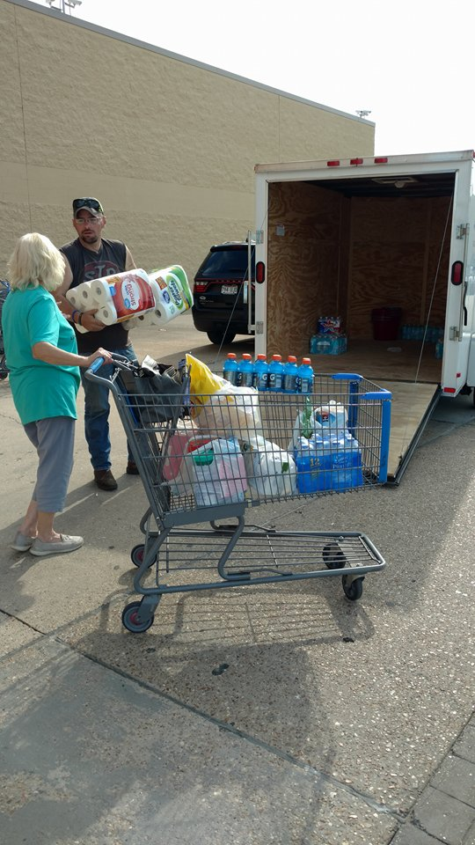

Slide 41
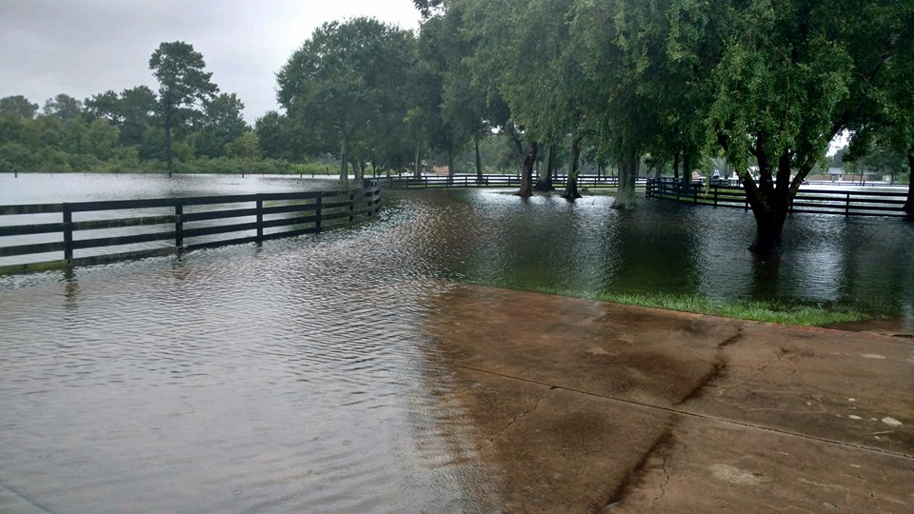

Slide 44
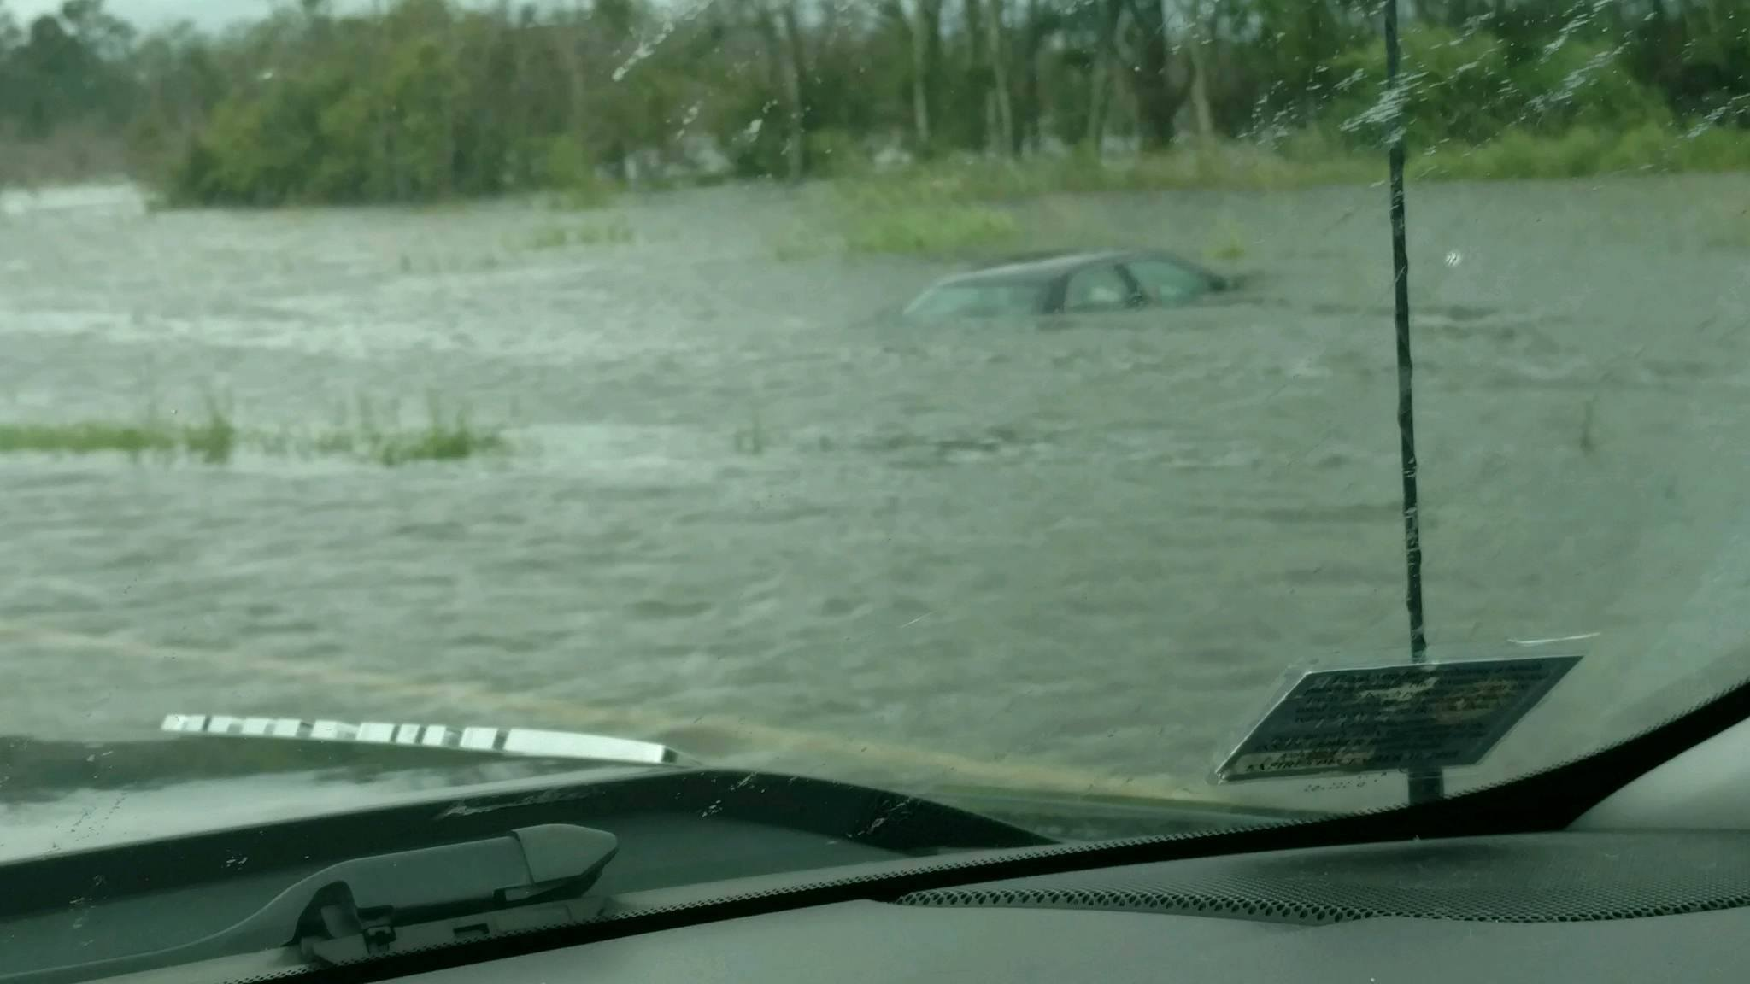

Slide 46
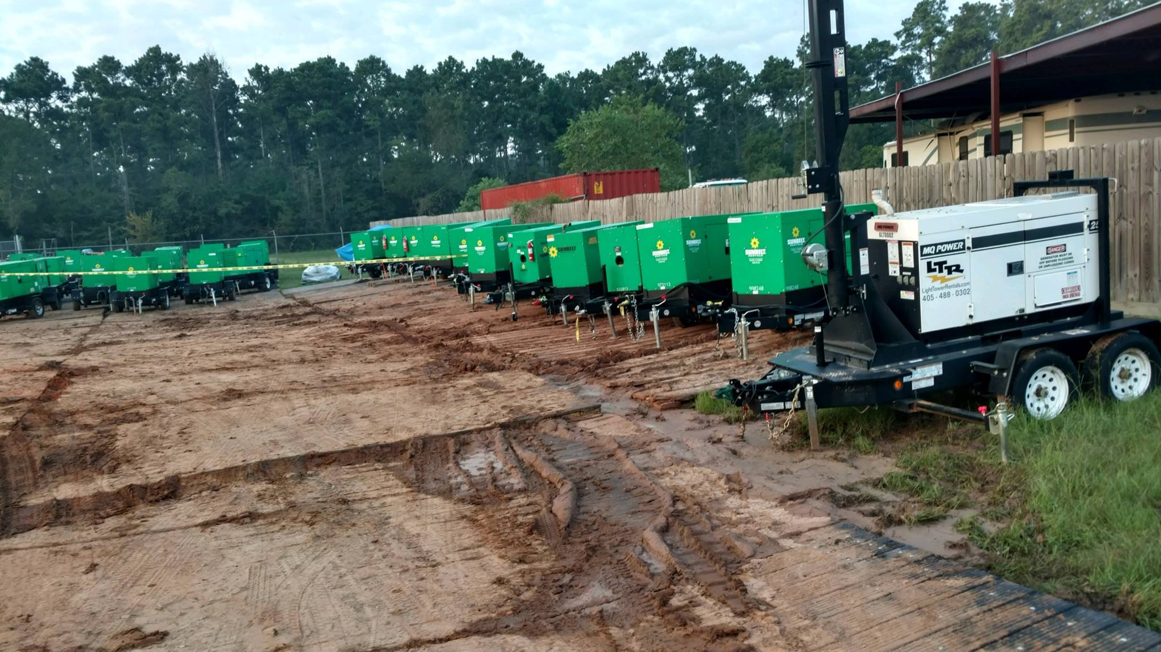

Slide 47
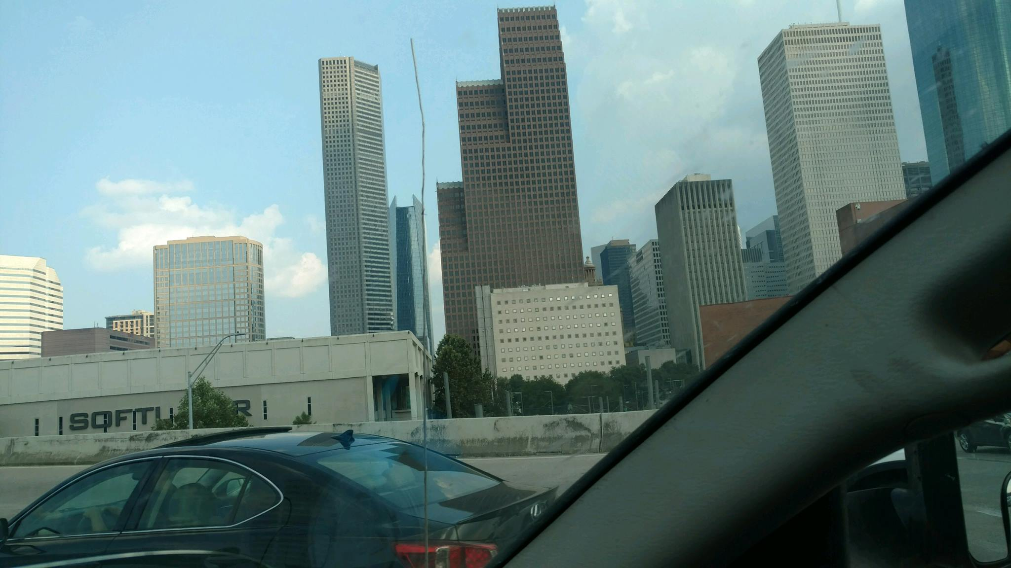

Slide 48
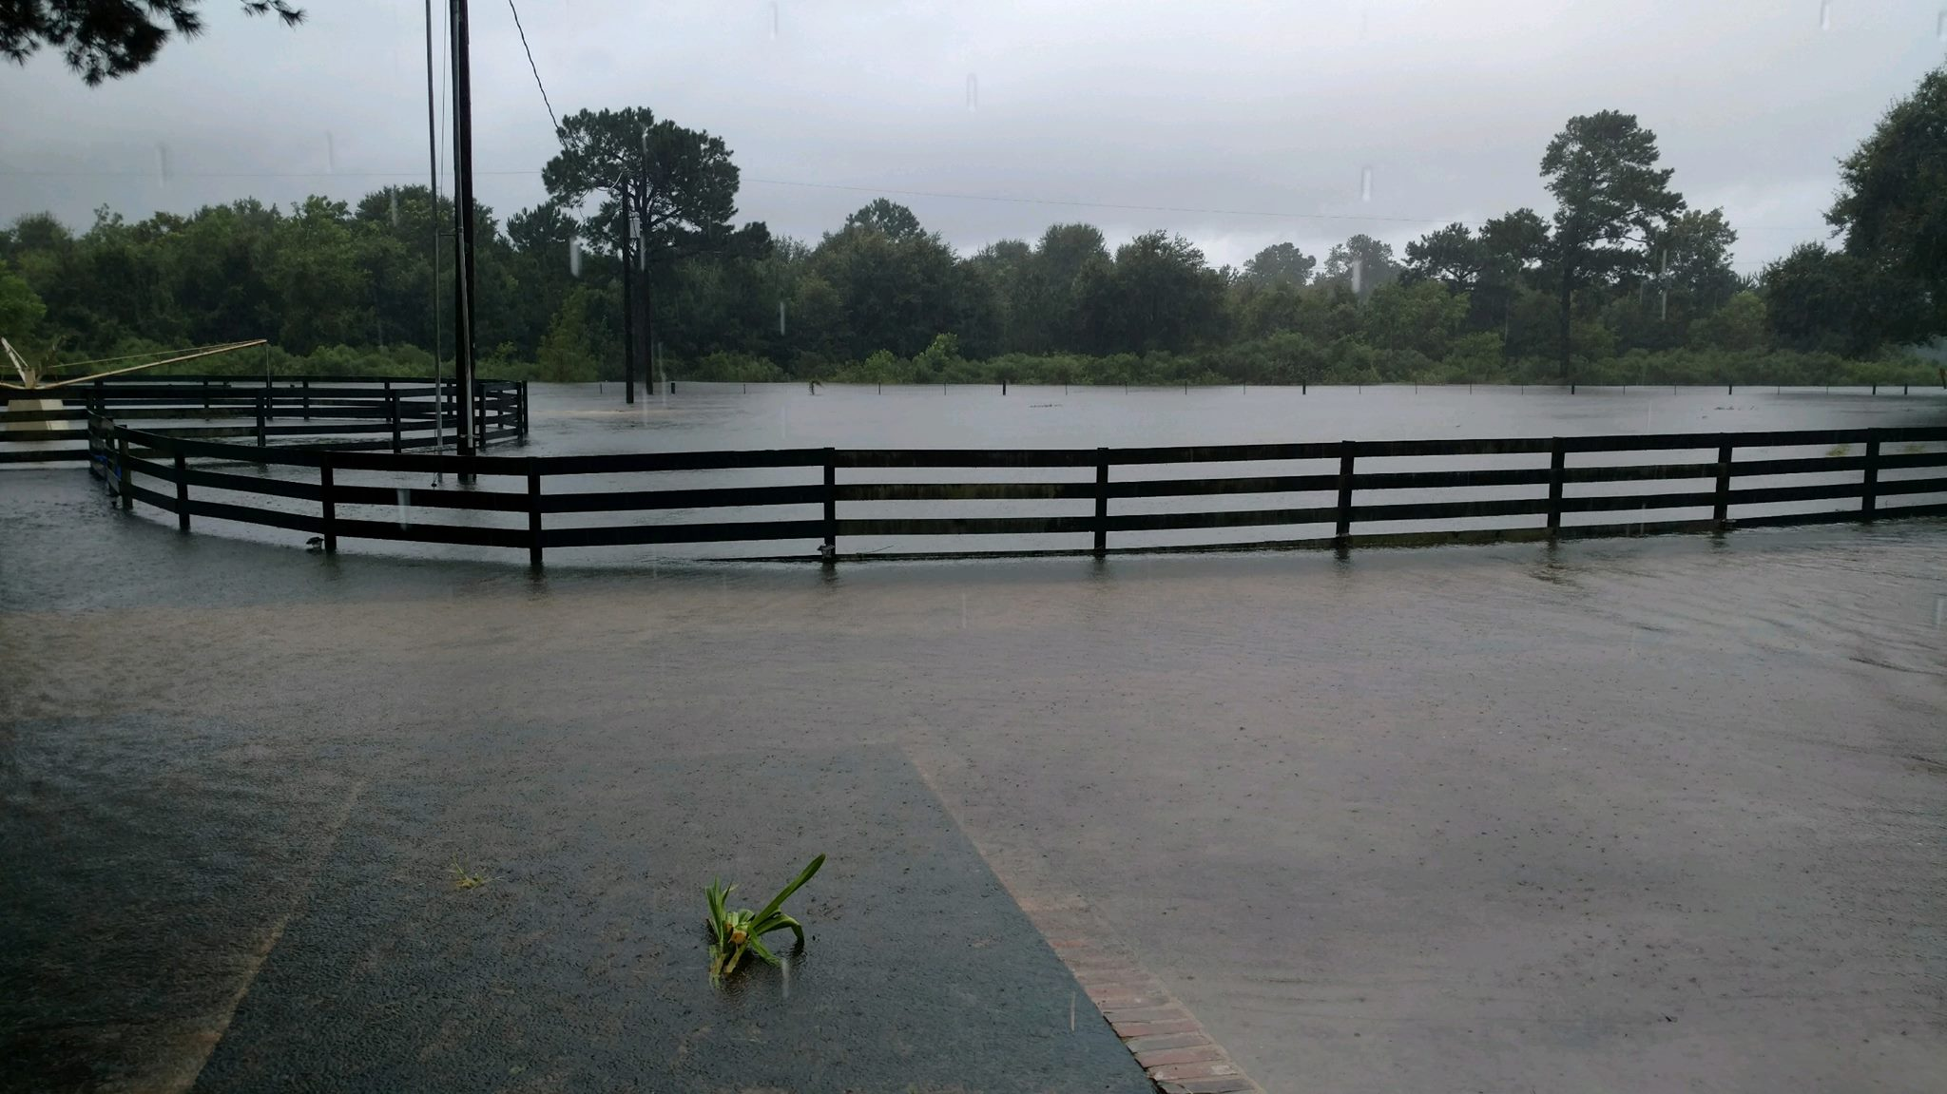

Slide 49
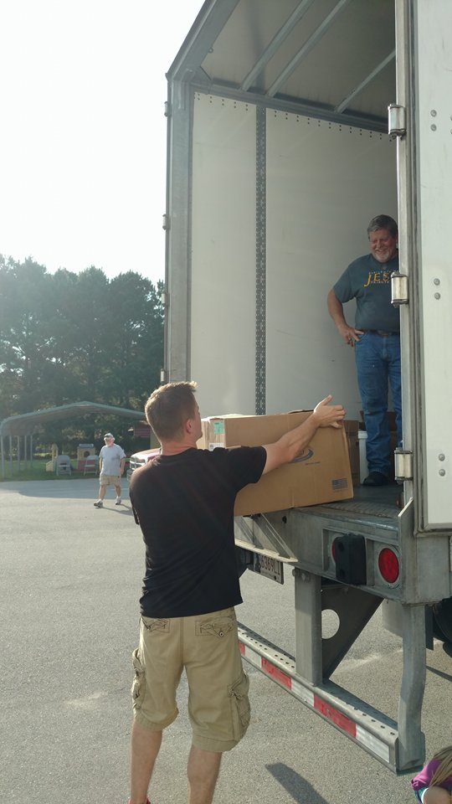

Slide 51
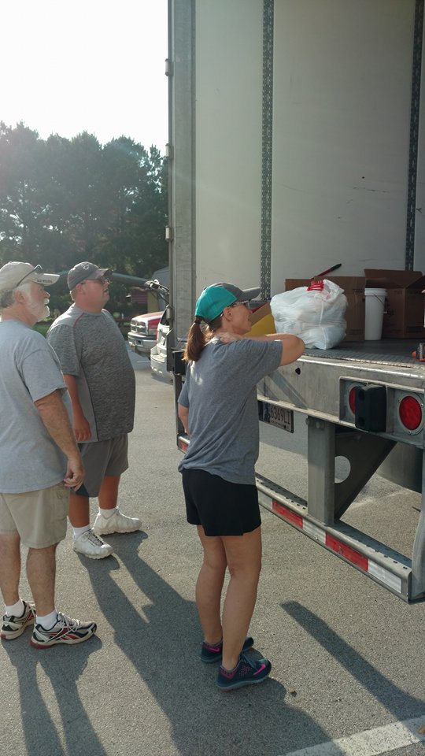

Slide 52
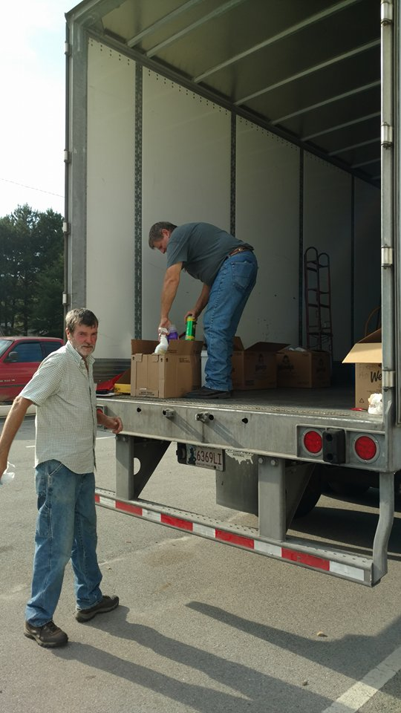

Slide 53
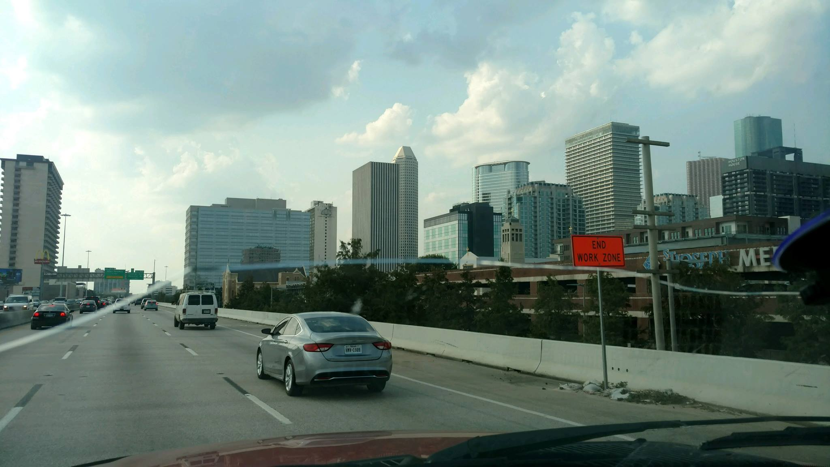

Slide 54
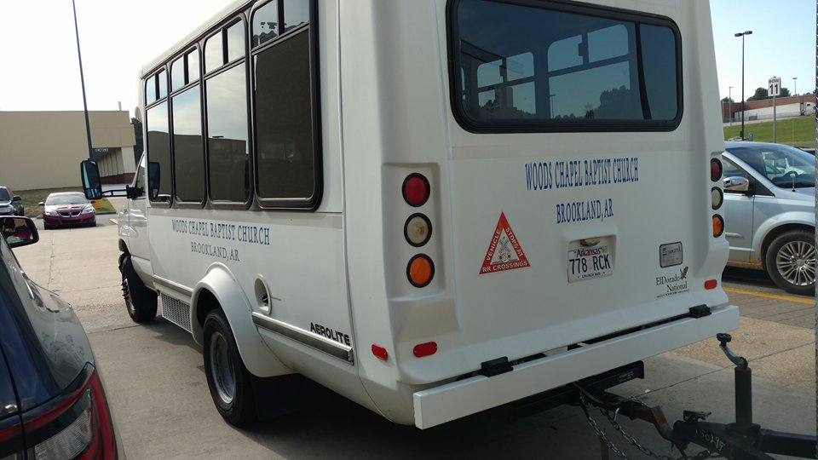

Slide 55
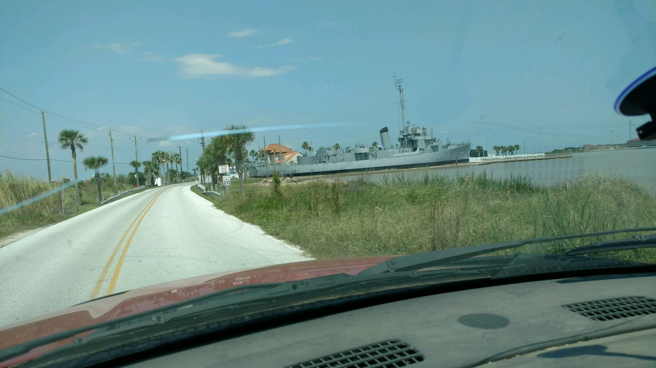

Slide 56
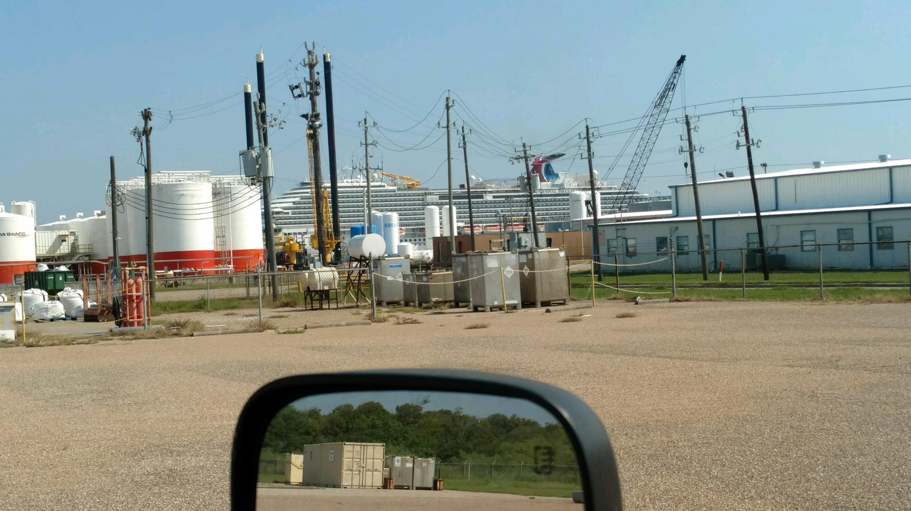

Slide 57
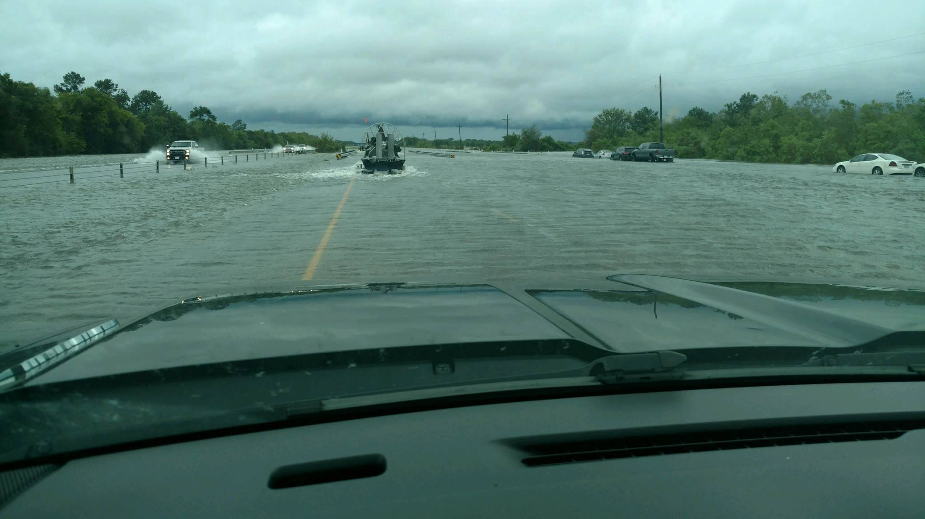

Slide 59
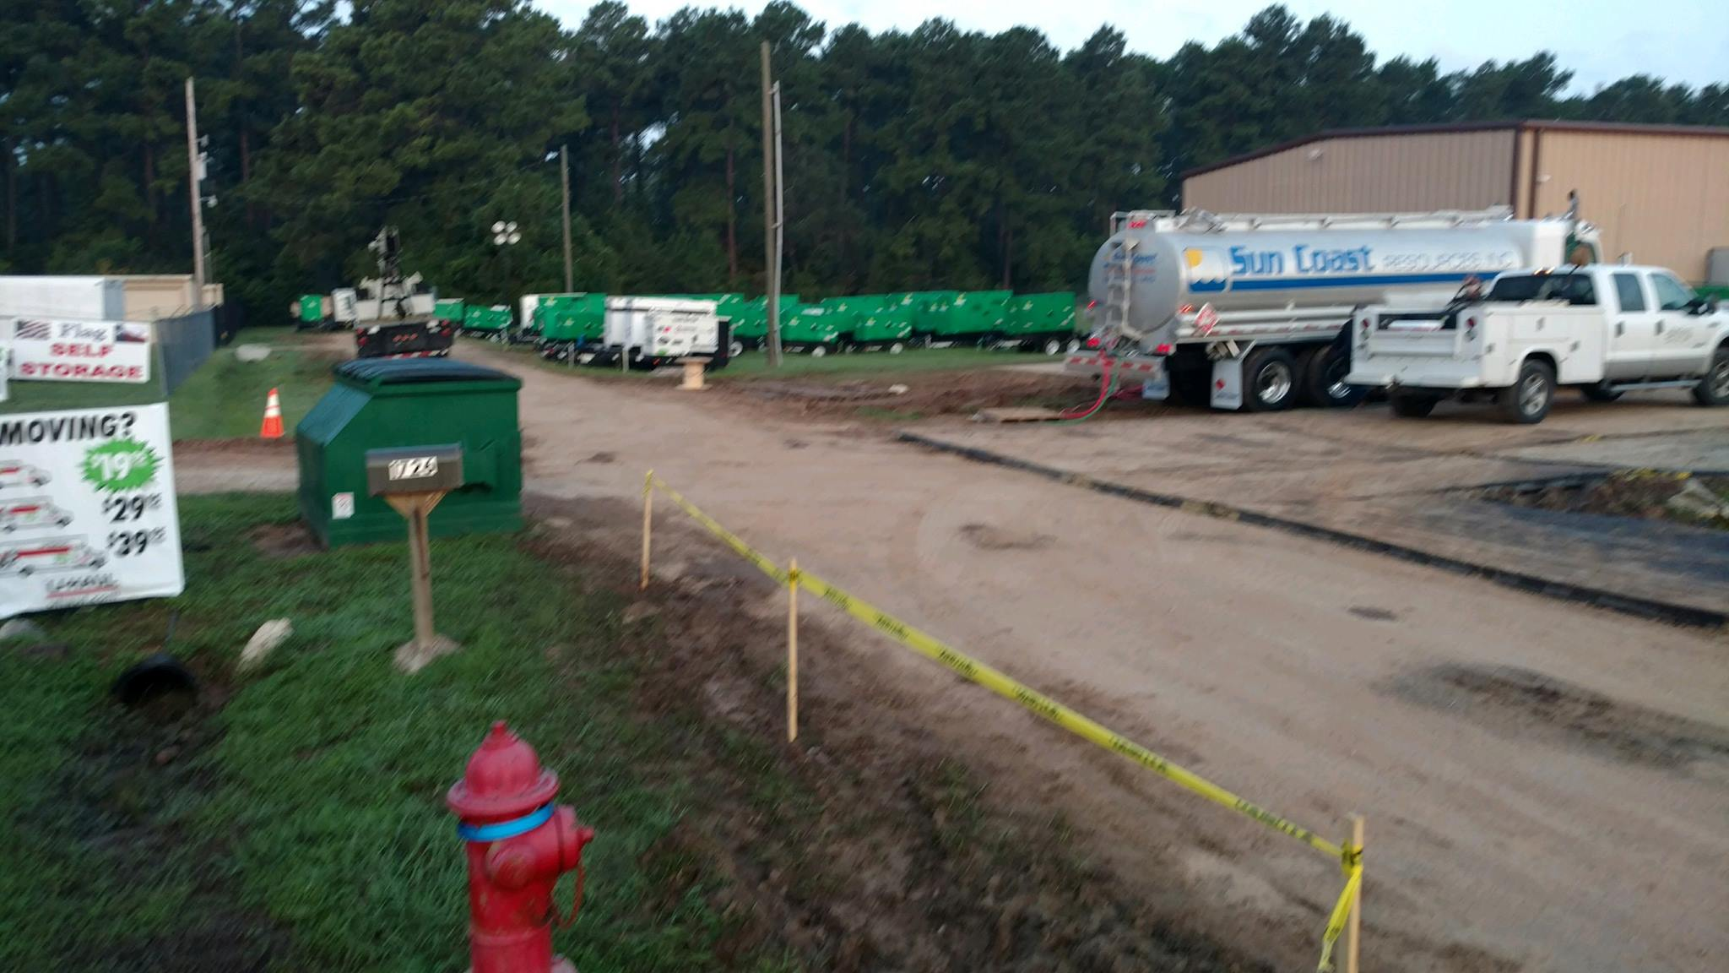

Slide 60
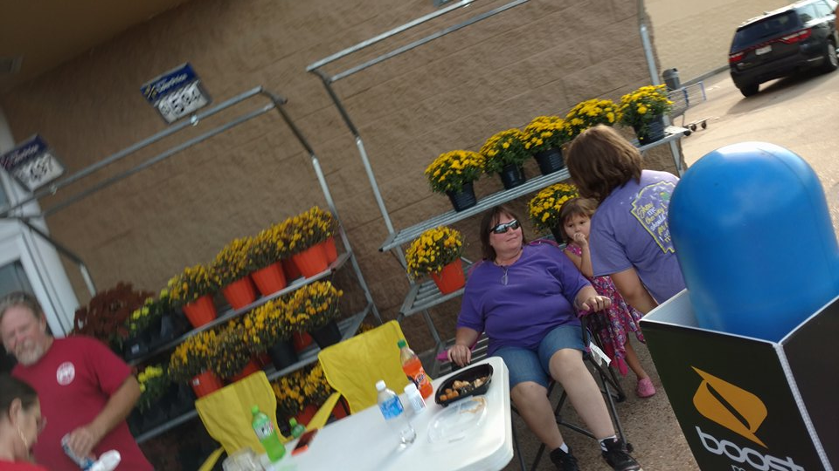

Slide 61
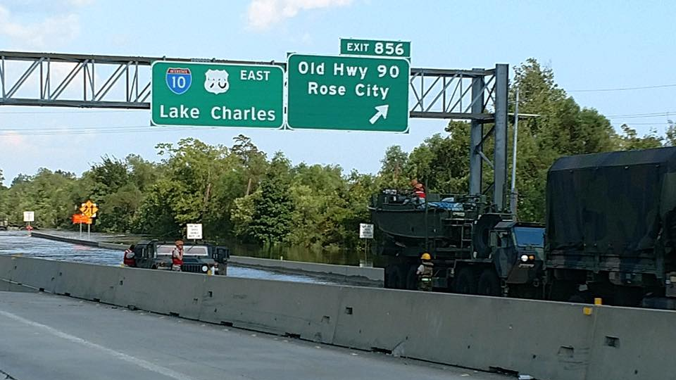

Slide 62
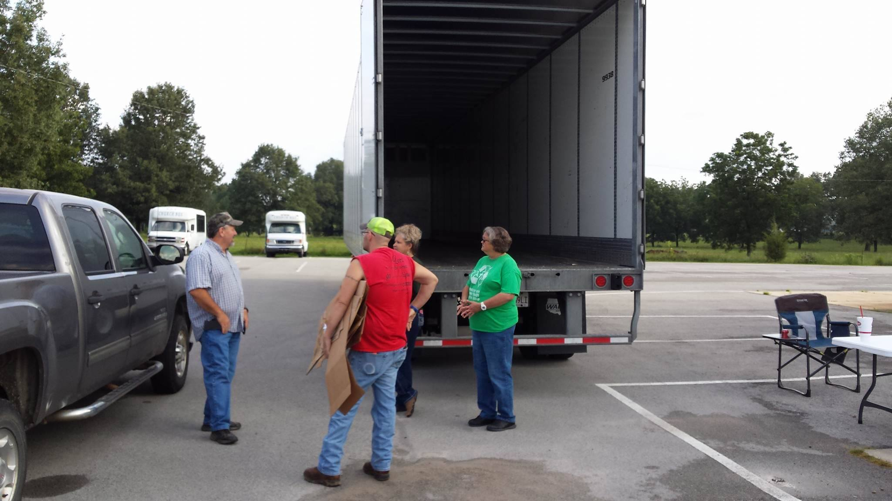

Slide 63
Resources
3304 Nederland Ave, Nederland, Tx 77627

Slide 64
Thank You to All those Lending a Helping Hand with Collecting supplies for Hurricane Harvey Storm Victims.
We appreciate You All for your Time and dedication to seeing a need and filling it!
Woods Chapel Church In Brookland, AR along with the help of Gary Beard Trucking from Trumann, AR , Take Hurricane Harvey By storm along with Team Arkansas branch of Cat5 Resources located in Nederland, TX.

Slide 65
There is Hope for Helpless
Rest for the Weary
Love for the Broken heart

Slide 66
WWW.WOODSCHAPELBAPTISTCHURCH.COM

